Slide 1
What is cloud computing

Slide 2
Nowadays, Cloud computing is adopted by every company,
whether it is an MNC or a startup.
Many are still migrating towards it because of its cost-efficiency, lesser maintenance,
and the increased capacity of the data with the help of servers maintained by the cloud providers.

Slide 3
Cloud Computing means storing and accessing data and programs on remote servers that are hosted on the internet instead of the computer's hard drive or local server.
Cloud computing is also referred to as Internet-based computing.
It is a technology where the resource is provided as a service through the Internet to the user.

Slide 4
The data that is stored can be files, images, documents, or any other storable document.

Slide 5
How Cloud Computing Works?
Cloud computing helps users easily access computing resources like storage and processing over the internet rather than local hardware.
we are discussing how it works

Slide 6
Infrastructure: Cloud computing depends on remote network servers hosted on the Internet to store, manage, and process data.
On-Demand Access: Users can access cloud services and resources on demand, scaling up or down without having to invest in physical hardware.
Types of Services: Cloud computing offers various benefits such as cost saving, scalability, reliability, and accessibility. It reduces capital expenditures, and improves efficiency.

Slide 7
Architecture Of Cloud Computing
Cloud computing architecture refers to the components and sub-components required for cloud computing.
Front end ( Fat client, Thin client)
Back-end platforms ( Servers, Storage )
Cloud-based delivery and a network ( Internet, Intranet, Intercloud )

Slide 8
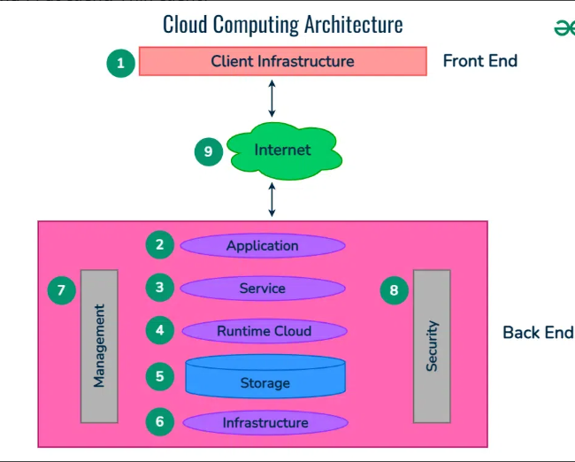

Slide 9
1. Front End ( User Interaction Enhancement )
The User Interface of Cloud Computing consists of 2 sections of clients.
The Thin clients are the ones that use web browsers facilitating portable and lightweight accessibilities and others are known as Fat Clients that use many functionalities for offering a strong user experience.

Slide 10
Back-end Platforms ( Cloud Computing Engine )
The core of cloud computing is made at back-end platforms with several servers for storage and processing computing.
Management of Applications logic is managed through servers and effective data handling is provided by storage.

Slide 11
3. Cloud-Based Delivery and Network
On-demand access to the computer and resources is provided over the Internet, Intranet, and Intercloud.
The Internet comes with global accessibility, the Intranet helps in internal communications of the services within the organization and the Intercloud enables interoperability across various cloud services

